Slide 1
KINGS COUNTY HOUSING DATA

Slide 2
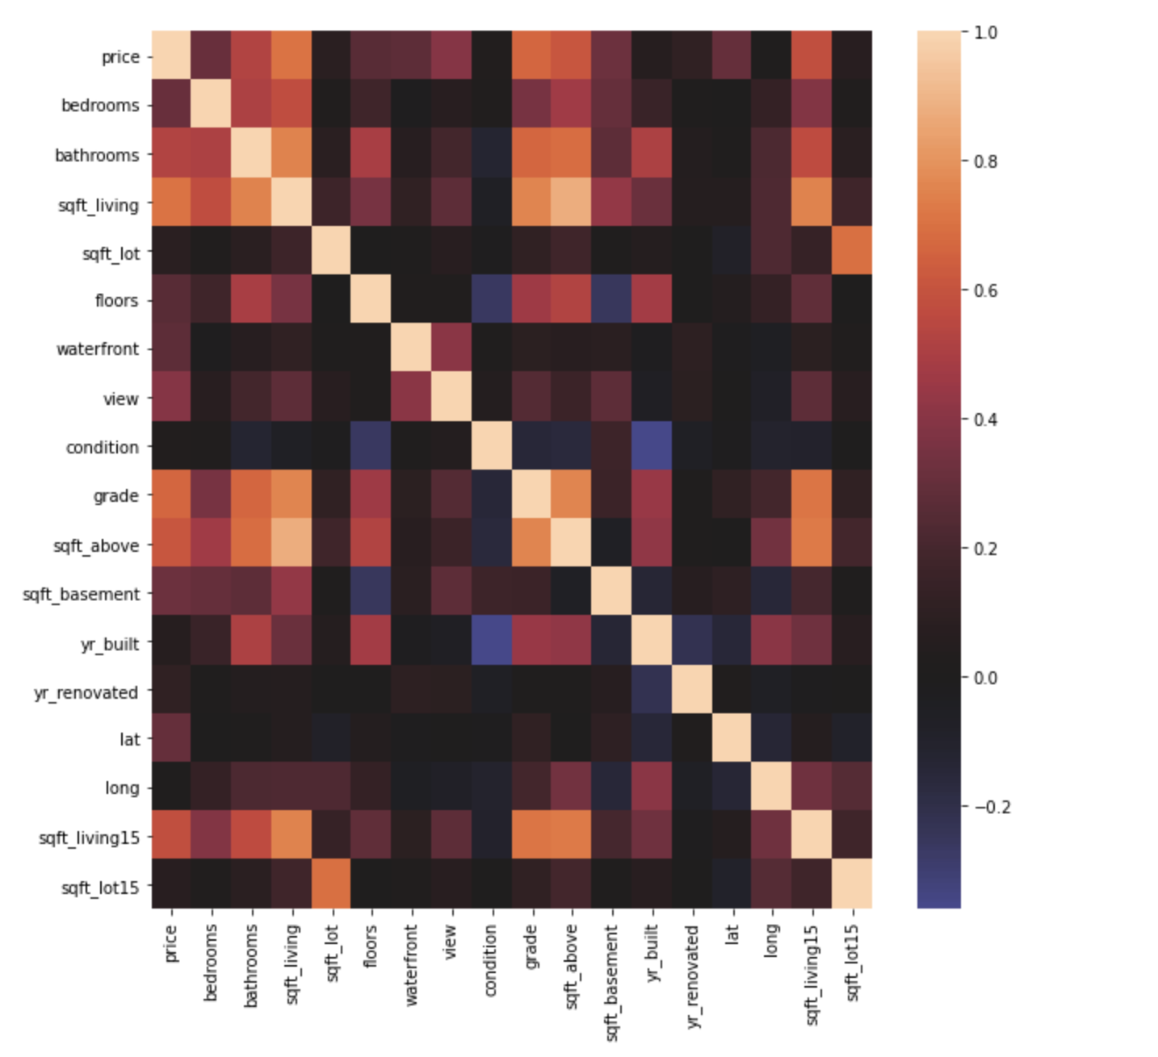
Correlation with Price

Slide 3
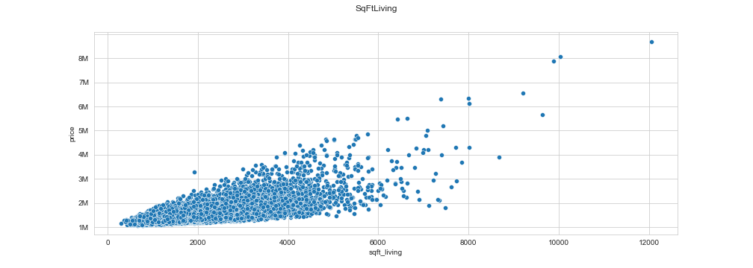
SQFT Living Vs Price
Notes:
Pay more for larger living space
Positive correlation with little to no exceptions

Slide 4
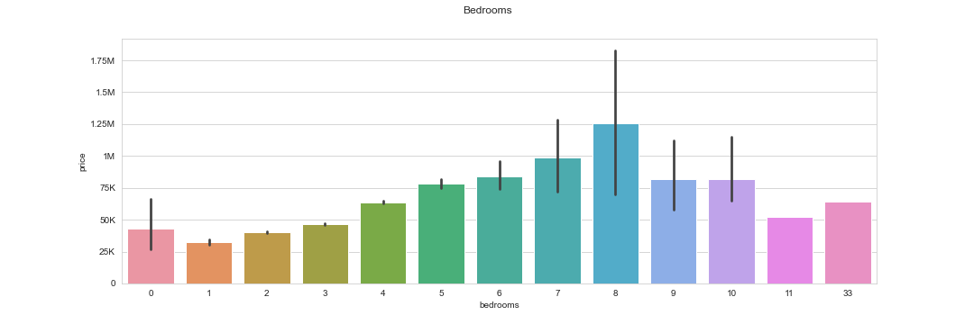
Housing Prices vs bedrooms
Notes:
Price per bedroom increases at first
Peak price is not at the max number of bedrooms

Slide 5
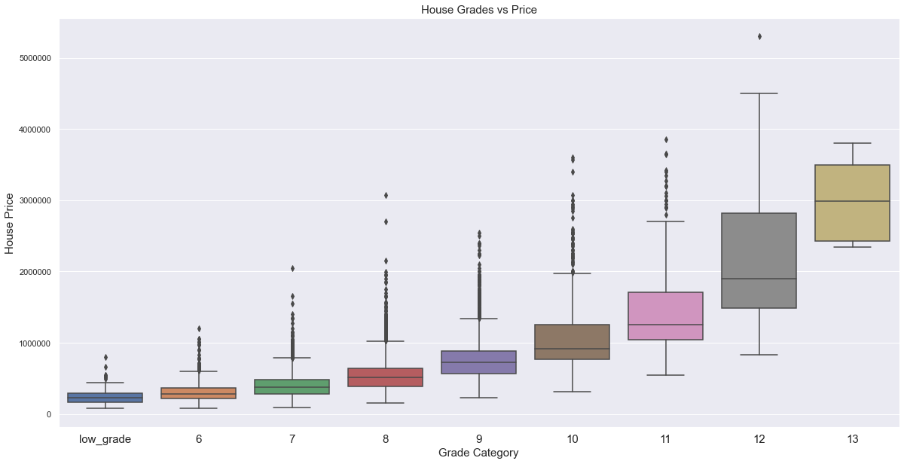
RELATIONSHIP OF HOUSE GRADES VS PRICE
Notes:
We see an exponential increase of price as the grade of the house increases

Slide 6
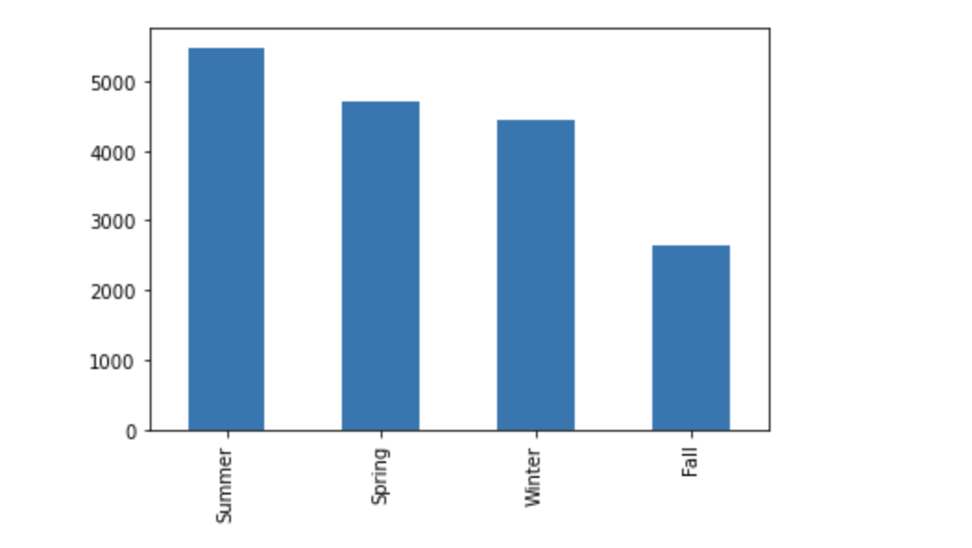
HOUSES SOLD BY SEASON
Grouped the houses sold by season in the official dates of each season .
As we see the highest amount of houses are sold in the summertime.

Slide 7
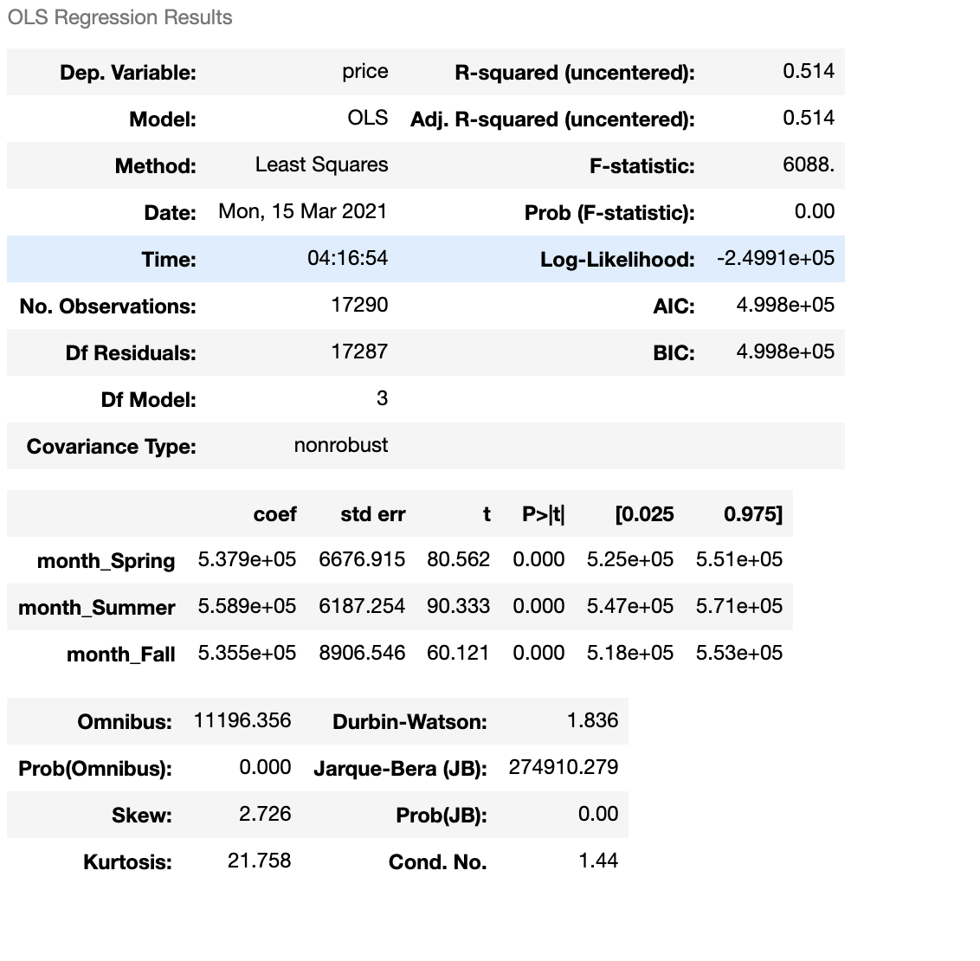
Initial OLS Regression Model

